Slide 1


Maharishi International University Modern Programming Practice Project Presentation
Library Management System
Group 8
Al Amir Saher Al Nassereddine
Ahmad Taher
Joe Sleiman

Slide 2
Outline
Introduction
Use Case Diagram
Class Diagram
Final Class Model
Sequence Diagram – Checkout Book & Add Copy
Validation Rules
Extra Credit Use Cases – Overdue & Checkout
SCI Knowledge 1 & 2
Slide 2 of 14

Slide 3
I. Introduction
The Library Management System is a state-of-the-art integrated library system that saves you time and money while making it easy to manage your entire library collection and circulation. Designed for use in public, school, academic and special libraries, Library Management System quickly and easily handles your daily activities while freeing up staff to serve your patrons with other valuable services.
Slide 3 of 14

Slide 4
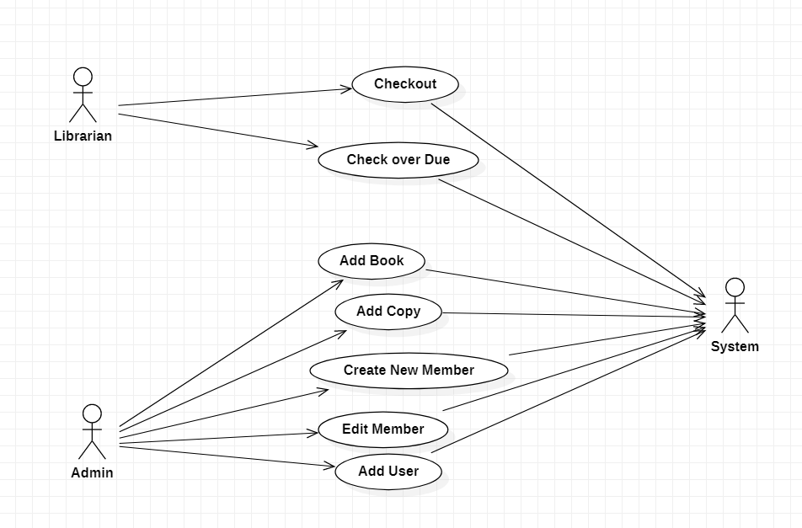
II. Use Case Diagram
Slide 4 of 14

Slide 5
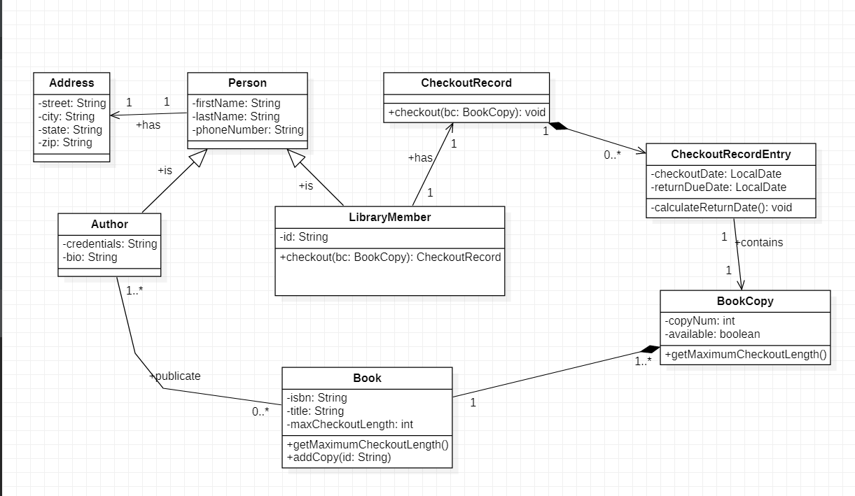
III. Class Diagram
Slide 5 of 14

Slide 6
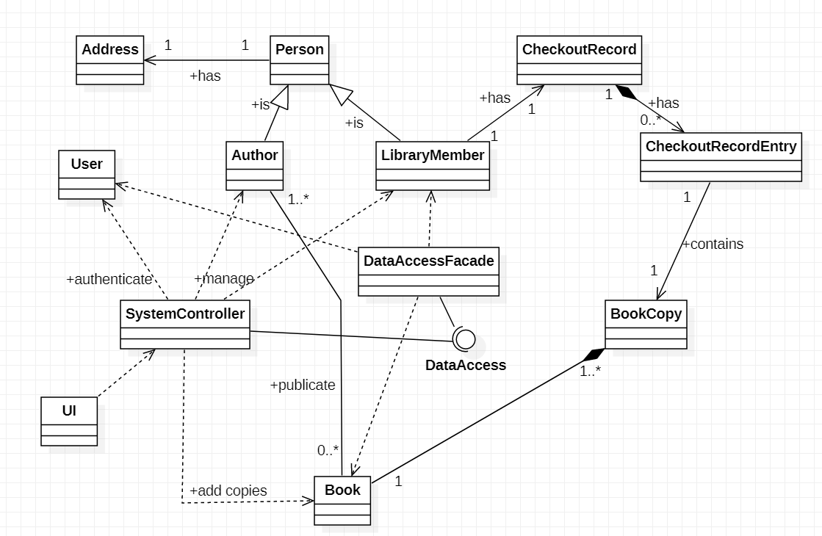
IV. Final Class Model
Slide 6 of 14

Slide 7
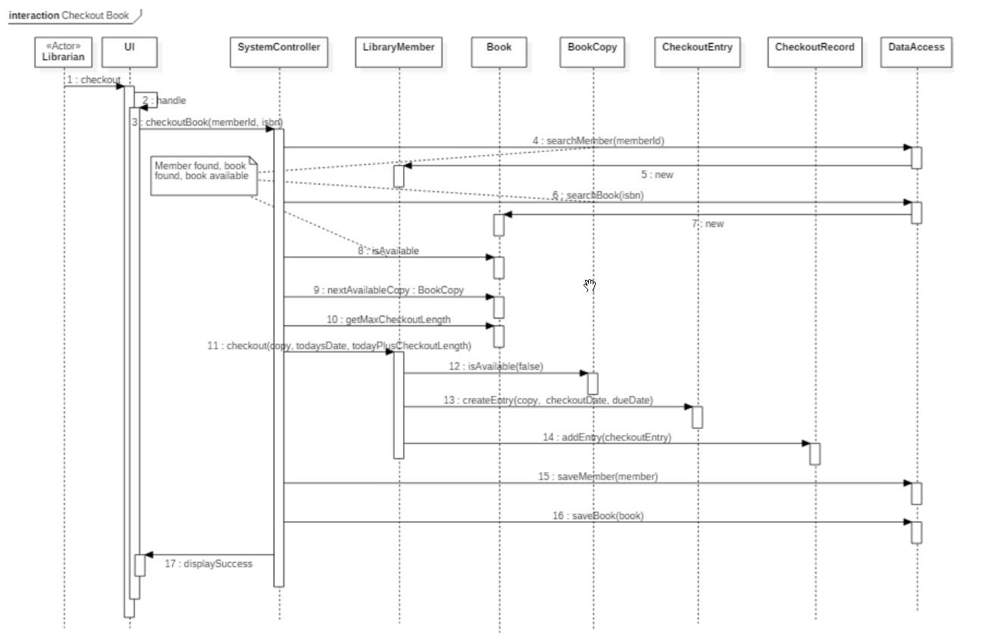
V. Sequence Diagram – Checkout Book
Slide 7 of 14

Slide 8
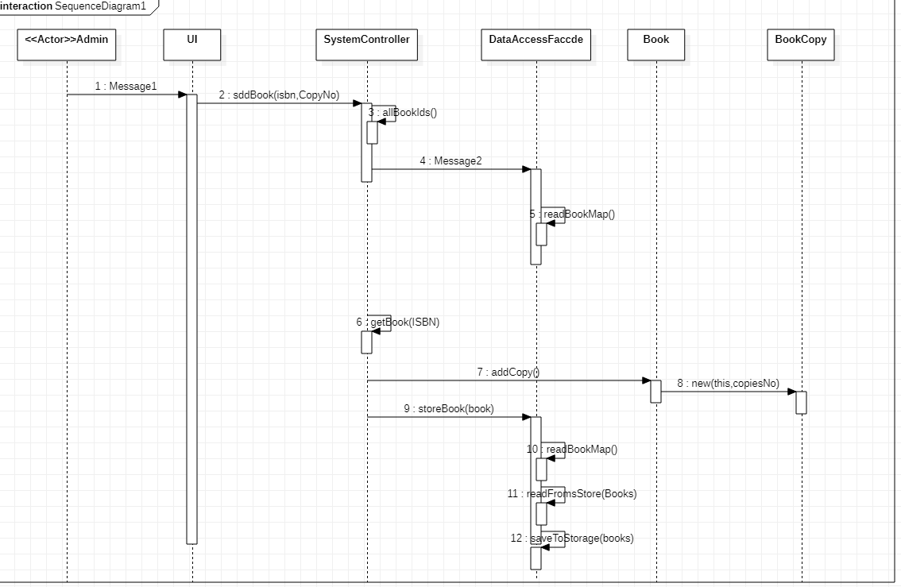
V. Sequence Diagram – Add Copy
Slide 8 of 14

Slide 9
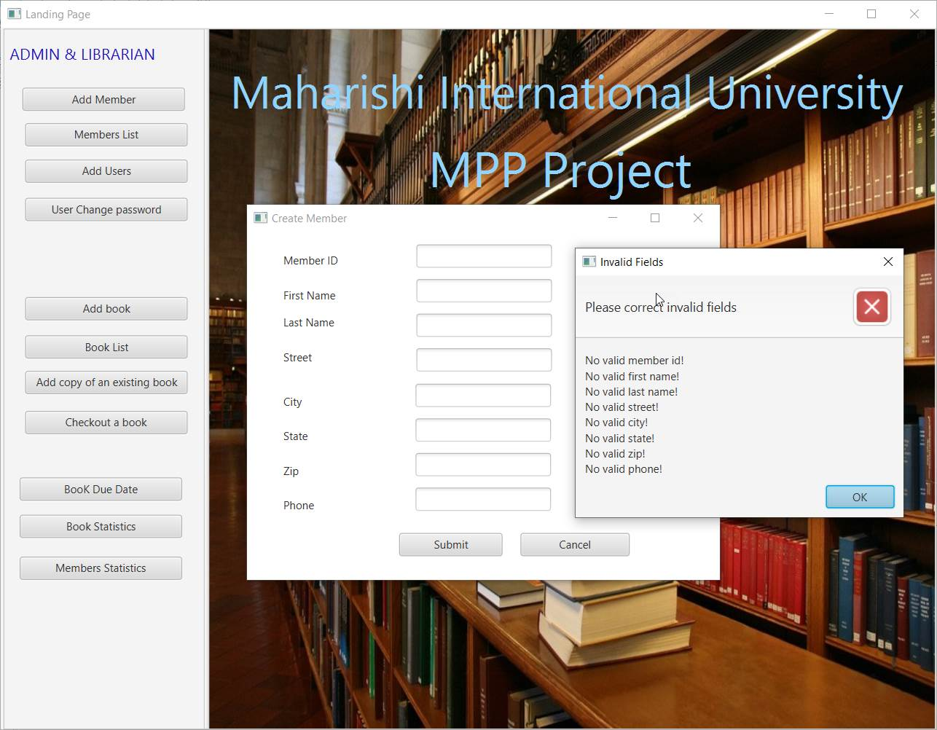
VI. Validation Rules
All mandatory fields are required from the user to fill before any operation is done. If any mandatory field is not filled an error message will show the invalid fields accordingly.
Slide 9 of 14

Slide 10
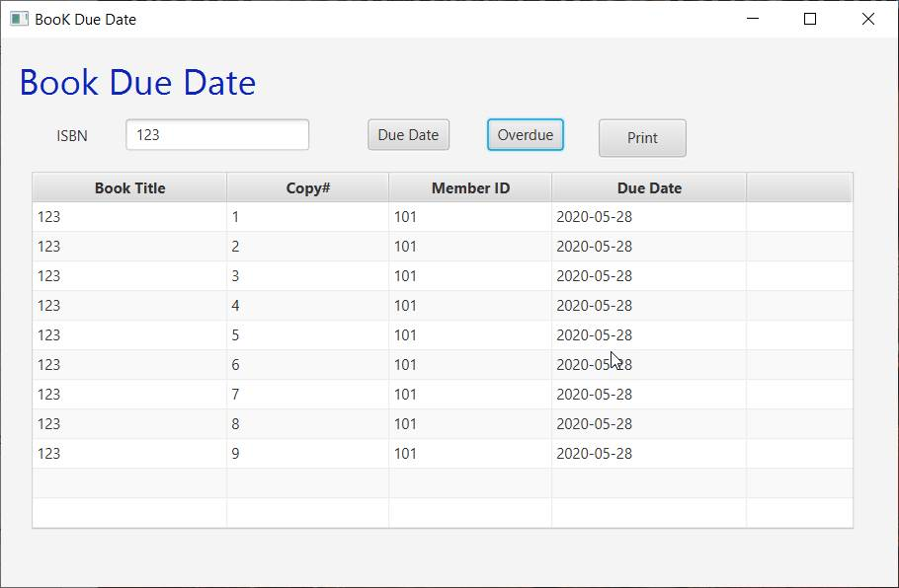
VII. Extra Credit Use Cases - Overdue
Overdue button will show all books overdue before today.
Due Date button will show all books checked out with their respective due dates.
Slide 10 of 14

Slide 11
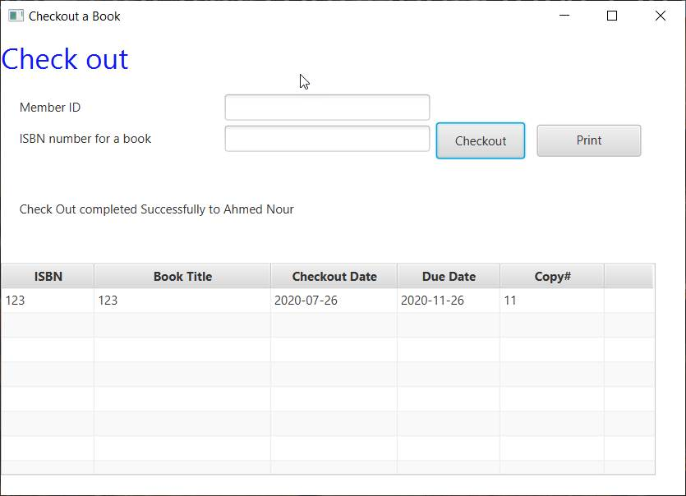
VII. Extra Credit Use Cases - Checkout
When the librarian check out a book, a table view will display information about the book the checkout and the due dates.
Print button will print the information on the console.
Slide 11 of 14

Slide 12
VIII. SCI Knowledge 1
Life is found in layers:
We split the program in many layers:
1- User Interface UI
2- Business
3- Data Access Layer
So as we know in life a human live inside another soul, his mother, he starts as seed layer, then he starts to grow until he born and start to grow up passing in different layers like layer of childhood that also include many other layers
like learning layer, walking layer etc... so also in our project we have to pass in different layers, build them, benefit and ease the work for us to make it more easier and understandable
for other developers.
We split the project in 3 main different layers as we mentioned above:
The UI is everything related to the images, graphics, users interface, input text, labels, buttons and user interaction with the screen, all exists in UI layer.
Business: the system controller class consist of everything related to Business between UI and Data Access Layer so we communicate with the Data Access Layer to get the necessary Data and react with it.
Data Access Layer: Everything related to Database so the important data we need to save them , we insert them into database so we can keep track of them.
Slide 12 of 14

Slide 13
VIII. SCI Knowledge 2
Every Action has a reaction:
In life, every action you do, you should reap the results, if you study a lot , the studying is an action, so obviously you will pass your exam, so as a result of your studying you get a grade that allow you to go to a upper level.
Same for our project, you have Screens you interact with it, the interactions are actions, you are responsible on every step you do, if you press a button of add book you will directed to the
page that will show you everything related to the add book operations, if you enter username and password as Librarian as an action in the login page, so as reaction if the credentials are correct you will get directed to the page that only display the options that can a librarian do.
So you interact with the system, you make decision , you act with the system, to achieve a goal or to get result, or to save book, to create member, to checkout a book, all these actions, have reactions like save the necessary data in a file (data base).

Slide 14
Thank You!

